Slide 1
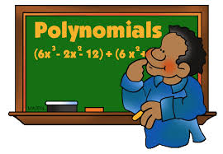
polynomials

Slide 2
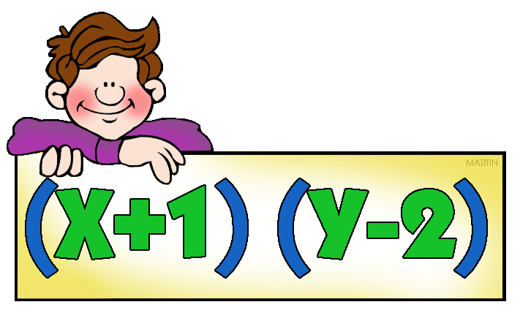
What is a polynomial?
An expression that can have constants, variables and exponents, that can be combined using addition, subtraction, multiplication and division, but: • no division by a variable.

Slide 3
Classification of polynomials
Monomial
A polynomial with only one term is called a monomial.
Binomial
A polynomial with only two terms is called a binomial.
Trinomial
A polynomial with only three terms is called a trinomial.
Zero Polynomial
The polynomial with all the coefficients as zeros is called a zero polynomial.

Slide 4
Degree of a Polynomial
The exponent of the term with the highest power is called the degree of the polynomial. The degree of a non-zero constant polynomial is zero. The degree of the zero polynomial is not defined.
A polynomial is named according to the degree of the polynomial:-
Linear Polynomial
A polynomial of degree one is called a first-degree or linear polynomial.
Quadratic Polynomial
A polynomial of degree two is called a second degree or quadratic polynomial
Cubic Polynomial
A polynomial of degree three is called a third-degree or cubic polynomial

Slide 5
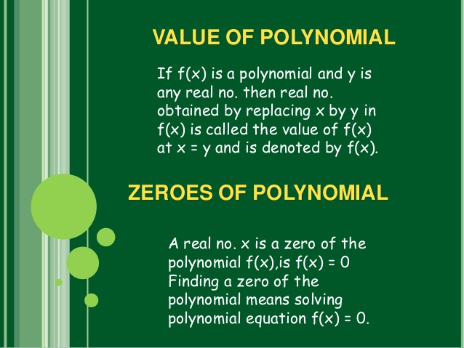

Slide 6
Remainder Theorem
Let p(x) be a polynomial in x of degree greater than or equal to 1 and 'a' be any real number. If p(x) is divided by (x – a), then the remainder is p(a).
If p(x) is divided by (x – a), then the remainder is r(x) and the quotient is q(x). Thus, p(x) = (x - a) q(x) + r(x).
The degree of r(x) is always less than the degree of (x - a). Since the degree of (x - a) is one, the degree of r(x) is zero i.e. r(x) is a constant.
So, for every value of x, r(x) = r. Therefore, p(x) = (x – a) q(x) + r

Slide 7
Factor Theorem
The factor theorem is a theorem linking factors and zeros of a polynomial.
The factor theorem states that a polynomial f(x) has a factor (x − k) if and only if f(k) = 0 .

Slide 8
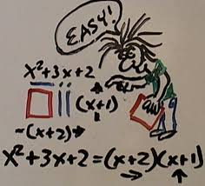
FACTORISATION
If g(x) and h(x) are two polynomials whose product is p(x). This can be written as p(x) = g(x) * h(x). g(x) and h(x) are called the factors of the polynomial p(x).
The process of resolving a given polynomial into factors is called factorisation. A non-zero constant is a factor of every polynomial.

Slide 9
METHODS OF FACTORISATION
REGROUPING
HCF
SPLITTING THE MIDDLE TERM
ALGEBRAIC IDENTITIES

Slide 10
Splitting the Middle Term
There is a method to factorize a quadratic expression known as splitting the middle term.
x² + 7x + 12
= x² + 3x + 4x + 12
= x (x + 3) + 4 (x + 3)
= (x + 3)(x + 4)
Here we observe that the coefficient of the middle term is the sum of the two numbers in each linear binomial and the last term is the product of the two numbers in each binomial.

Slide 11
Algebraic Identities
Polynomials can be factorised using algebraic identities.
A polynomial of degree two is called a quadratic polynomial. The identities used to factorise the quadratic polynomials are:
(a + b)² = a² + 2ab + b²
(a – b)² = a² – 2ab + b²
(a + b)(a – b) = a² – b²
(x + a)(x + b) = x² + (a + b)x + ab
(a + b + c)² = a² + b² + c² + 2ab + 2bc + 2ca

Slide 12
A polynomial of degree three is called a cubic polynomial. The algebraic identities used to factorise a cubic polynomial are:
(a + b)³ = a³ + b³ + 3ab (a + b)
(a – b)³ = a³ – b³ – 3ab (a – b)
a³ + b³ = (a + b)(a² – ab + b²)
a³ – b³ = (a – b)(a² + ab + b²)
a³ + b³ + c³ – 3abc = (a + b + c)(a² + b² + c² – ab – bc – ca)

Slide 13


